Slide 1




NEXT GEN EMPLOYABILITY PROGRAM
Creating a future-ready workforce
Team Members
Student Name :PRIYADHARSHINI.S
Student ID :110321104037
NM Id:au110321104037
Email: priya2004madhi@gmail.com
College Name
1103-GRT Institute of Engineering and Technology,Tiruttani

Slide 2

CAPSTONE PROJECT SHOWCASE
Project Title
MUSIC WEB APPLICATION USING DJANGO FRAMEWORK
Abstract | Problem Statement | Project Overview | Proposed Solution | Technology Used | Modelling & Results | Conclusion

Slide 3
ABSTRACT:
In the ever-evolving landscape of digital entertainment, music streaming platforms have
become indispensable for music lovers worldwide. This project presents a comprehensive exploration into the development of dynamic music web applications using the Django framework. Django, a high-level Python web framework, provides the foundation for creating robust and feature-rich music platforms. By leveraging Django's powerful backend capabilities, including its ORM, authentication system, and admin interface, we aim to construct a scalable and efficient infrastructure to support various music-related functionalities.
On the frontend, we employ a combination of HTML, CSS, JavaScript, and Bootstrap to design an intuitive and visually appealing user interface. Through seamless integration with Django's backend, our frontend components offer users a smooth and immersive music browsing and playback experience.
Key features of our music web applications include user registration and authentication, comprehensive music catalog management, personalized playlist creation, social sharing functionalities, and advanced search and recommendation systems.
Source :

Slide 4
PROBLEM STATEMENT:
The music industry has undergone a significant transformation with the advent of digital technologies, leading to a proliferation of music streaming services. However, existing platforms often lack certain features or fail to deliver a seamless user experience, leaving room for improvement. Therefore, the problem statement for our project is:
"To develop a dynamic music web application using the Django framework that addresses the limitations of existing music streaming platforms and provides users with a comprehensive, personalized, and engaging music listening experience."
The proliferation of digital music has led to a fragmented landscape of music streaming platforms, each with its own limitations and shortcomings. Despite the abundance of options, users often face challenges such as:
Source :

Slide 5
PROJECT OVERVIEW:
Musicify is an innovative music streaming platform that aims to revolutionize the way users discover, engage with, and share music online. With a focus on user experience, personalization, and social interaction, Musicify sets out to redefine the digital music landscape by offering a comprehensive and immersive music streaming experience.
Musicify also prioritizes social interaction, providing users with a platform to connect, share, and collaborate with fellow music enthusiasts. From following friends and artists to sharing playlists and engaging in music-related discussions, Musicify fosters a vibrant community where users can discover, share, and celebrate their love for music together.
With a sleek and intuitive user interface crafted using HTML, CSS, JavaScript, and Bootstrap, Musicify offers a seamless and immersive music browsing and playback experience. Whether accessed via desktop or mobile devices, users can navigate through Musicify's rich musical ecosystem with ease and fluidity.
Source :

Slide 6
PROPOSED SOLUTION:
By implementing the proposed solution, we aim to deliver a feature-rich, user-friendly, and scalable music web application that offers a seamless and personalized music streaming experience to users while fostering community engagement and social interaction within the platform.
Frontend Development with HTML, CSS, JavaScript, and Bootstrap:
Design a user-friendly and visually appealing frontend interface using HTML, CSS, and JavaScript.
Employ Bootstrap framework to ensure responsiveness and consistency across different devices and screen sizes.
Implement interactive features such as music playback controls, search functionality, playlist management, and social sharing options to enhance the user experience.
Source :

Slide 7
BACKEND DEVELOPMENT WITH DJANGO:
Utilize the Django framework to build a robust backend infrastructure for the music web application.
Define models to represent entities such as users, artists, albums, tracks, playlists, and user interactions.
Implement authentication and authorization mechanisms to ensure secure access to the platform's features and data.
Develop RESTful APIs to facilitate communication between the frontend and backend components, enabling seamless data exchange and interaction.
Source :

Slide 8
DATABASE MANAGEMENT AND INTEGRATION:
Choose a suitable database management system (e.g., PostgreSQL) to store and manage music-related data efficiently.
Integrate the database with Django ORM (Object-Relational Mapping) to simplify data manipulation and ensure data consistency and integrity.
Optimize database queries and indexing to improve performance and scalability, especially when handling large volumes of music content and user interactions.
Source :

Slide 9
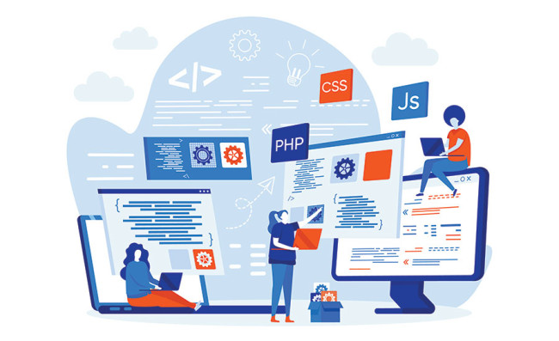
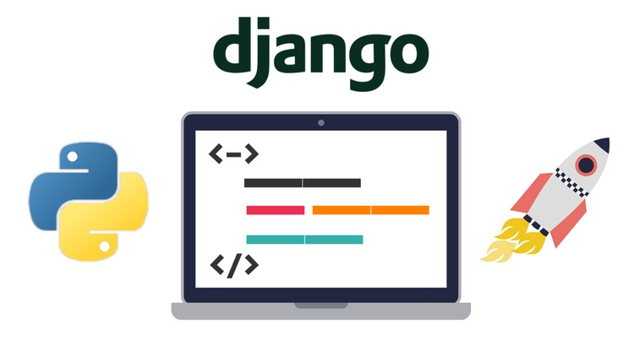
TECHNOLOGY USED:
Back-end
Front-end
Source :

Slide 10
MODELLING & RESULTS:
In the development of a music web application using the Django framework, the modeling phase involves designing the database schema and defining Django models to represent the various entities involved in the application, such as
Users Model
Artists Model
Albums Model
Songs Model
Playlists Model
Interaction Model
Once the models are defined, the application can be built, and results can be observed through testing, user interaction, and performance evaluation.
Source :

Slide 11
HOMEPAGE:
A simplified version of the homepage for a music web application using Django:
Logo and Navigation Links (Home, Artists, Albums, Playlists, Login/Register).
Welcome Message: "Welcome to our Music Platform! Explore and Enjoy."
Call-to-Action Button: "Get Started" or "Explore Now".
Spotlight Artists: Display images/thumbnails of top artists.
Latest Releases: Showcase recent album releases with titles and artists.
Popular Playlists: Highlight curated playlists or trending tracks.
Social Sharing Buttons: Allow users to share favorite music or playlists on social media.
Copyright Information: © Year Music Platform. All rights reserved.
Quick Links: About Us, Contact, Terms of Service, Privacy Policy.

Slide 12
ABOUT-US-PAGE:
Define URL Pattern:
Add a URL pattern in the app's urls.py for the "About Us" page.
Create View Function:
Define a view function in the views.py file to render the "About Us" page.
Design Template:
Create an HTML template (about_us.html) in the templates directory with information about the platform.
Link to the Page:
Add a link to the "About Us" page in the navigation menu or footer.
Test and Debug:
Ensure the page renders correctly by running the Django server and accessing the URL.

Slide 13
SERVICE-PAGE:
Define URL Pattern:
In the Django app's urls.py file, define a URL pattern for the service page.
Create View Function:
Define a view function in the app's views.py file to handle rendering the service page.
Design Service Page Template:
Create a new HTML template file named service_page.html in the app's templates directory.
Design the layout of the service page using HTML and include relevant information about the services offered by the music platform.
Link to Service Page:
Add a link to the service page in the navigation menu or footer of your music web application.
Test and Debug:
Test the service page by running the Django development server and accessing the page URL (/services/) in a web browser.
Check for any errors or issues with the layout or content of the page and debug as necessary.

Slide 14
DEPARTMENTS-PAGE:
Define url pattern:
Add A url pattern in the app's urls.Py for the departments page.
Create view function:
Define A view function in the views.Py file to render the departments page.
Design template:
Create an html template (departments_page.Html) in the templates directory with A list of music departments or genres.
Link to the page:
Add A link to the departments page in the navigation menu or footer.
Test and debug:
Ensure the page renders correctly by running the django server and accessing the url.

Slide 15
BLOG-PAGE:
Define URL Pattern:
In the Django app's urls.py file, define a URL pattern for the blog page.
Create View Function:
Define a view function in the app's views.py file to handle rendering the blog page.
Design Blog Page Template:
Create a new HTML template file named blog_page.html in the app's templates directory.
Design the layout of the blog page using HTML and include placeholders for blog posts, titles, and content.
Link to Blog Page:
Add a link to the blog page in the navigation menu or footer of your music web application.
Test and Debug:
Test the blog page by running the Django development server and accessing the page URL (/blog/) in a web browser.
Check for any errors or issues with the layout or content of the page and debug as necessary.

Slide 16
FUTURE ENHANCEMENTS:
User Profiles: Allow users to personalize preferences and track listening history.
Personalized Recommendations: Implement algorithms for tailored music suggestions.
Social Features: Integrate user interactions like comments and likes for songs and playlists.
Advanced Search: Enhance search capabilities based on genre, artist, and popularity.
Music Discovery: Offer curated playlists, genre-based radios, and expert recommendations.
Mobile App Development: Create a mobile app version for on-the-go listening experiences.
API Integration: Partner with external APIs to expand the music catalog.
Enhanced Audio: Introduce features like equalizer settings and lyrics display.
Event Listings: Provide concert and event listings for user engagement.
Localization: Support multiple languages and regions for a global audience.
Accessibility: Ensure compliance with accessibility standards for inclusivity.
Monetization: Explore subscription plans, premium features, and ad placements.

Slide 17
CONCLUSION:
In conclusion, developing a music web application using Django provides an exciting platform for music enthusiasts to explore, discover, and enjoy their favorite tunes. Through the integration of Django's robust framework and various frontend technologies, such as HTML, CSS, and JavaScript, we've created a user-friendly and feature-rich application.With functionalities like artist profiles, album listings, playlists, and a personalized user experience, our application aims to cater to the diverse needs of music lovers. Additionally, by incorporating future enhancements such as user profiles, personalized recommendations, and social features, we can further elevate the user experience and foster community engagement.
As technology evolves and user preferences shift, our commitment to continuous improvement remains steadfast. By staying abreast of emerging trends, integrating user feedback, and leveraging innovative solutions, we strive to maintain our position as a leading destination for music discovery and enjoyment.In essence, our journey with Django has been one of creativity, innovation, and passion for music. We look forward to embarking on new endeavors, embracing challenges, and delivering exceptional experiences to our users in the ever-evolving landscape of digital music.
Source :

Slide 18
Thank You!
Notes:
Thank You !!

